Slide 1

DESIGN AND ANALYSIS OF ALGORITHMS (113939)
Dr. Owais Hussain

Slide 2
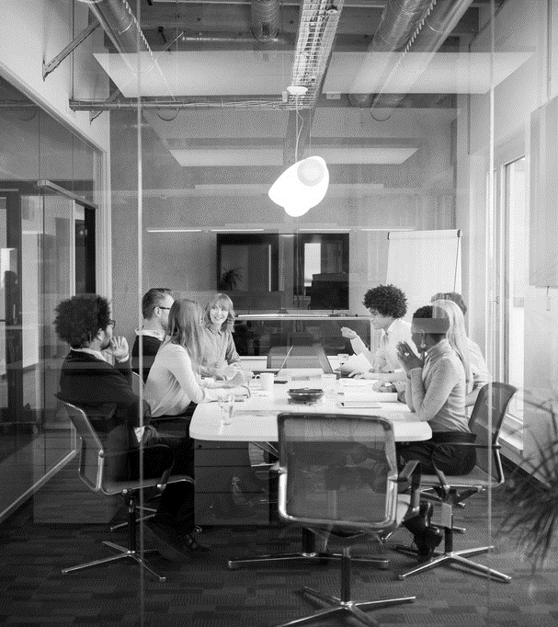
Agenda
Greedy Desing Strategy
A Simple Example
Exercise
Huffman Coding
Exercise
Optimization of Group Formation Algorithm using Greedy approach
Influence Maximization Problem

Slide 3
Sample 2
Greedy Design Strategy
Greedy is exactly as it sounds like. You design your solution based on the current situation.
Greedy does not guarantee global optimal solution. However, it does offer a local optimal solution.
Identifies all possible immediate solutions and chooses the best solution among that set.

Slide 4
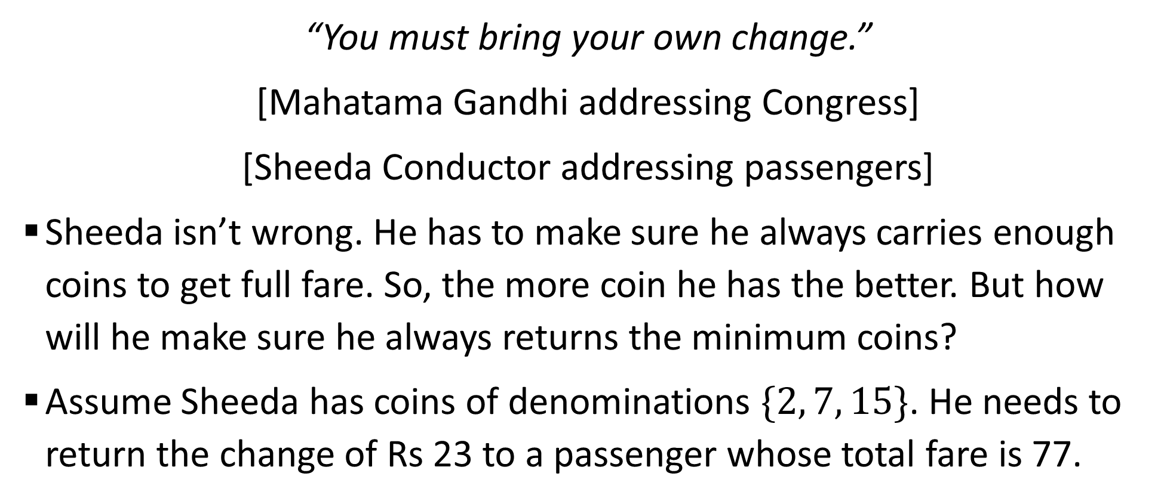
Sample 2
A Simple Example
“You must bring your own change.”
[Mahatama Gandhi addressing Congress]
[Sheeda Conductor addressing passengers]
Sheeda isn’t wrong. He has to make sure he always carries enough coins to get full fare. So, the more coin he has the better. But how will he make sure he always returns the minimum coins?
Assume Sheeda has coins of denominations $\{2, 7, 15\}$. He needs to return the change of Rs 23 to a passenger whose total fare is 77.

Slide 5
Sample 2
A Simple Example
The objective is to return the change in minimum number of coins needed.
Greedy approach:
Pick handful of coin and pick the highest coin closest to Rs. 23.
Sheeda picks a coin of Rs. 15. The remaining amount is now Rs. 8.
He then picks a coin of Rs. 7. The remaining amount is now 1.
There are no coins of Rs. 1, so he removes the last coin of Rs. 7.
He then picks 8 coins of Rs. 1. Remaining amount is 0. The problem is solved using 9 coins.

Slide 6
Sample 2
A Simple Example
Upon examination, one can easily guess that he only needed 4 coins of Rs. 7 and 1 coin of Rs. 2, which was the optimal solution.
However, in order to guarantee without simply making guesses, we require all possible combinations which total to the desired amount.
Therefore, the Greedy solution is a good option here.
It’s important to note that Greedy approach may not guarantee optimal result, but that does not mean it never will.

Slide 7
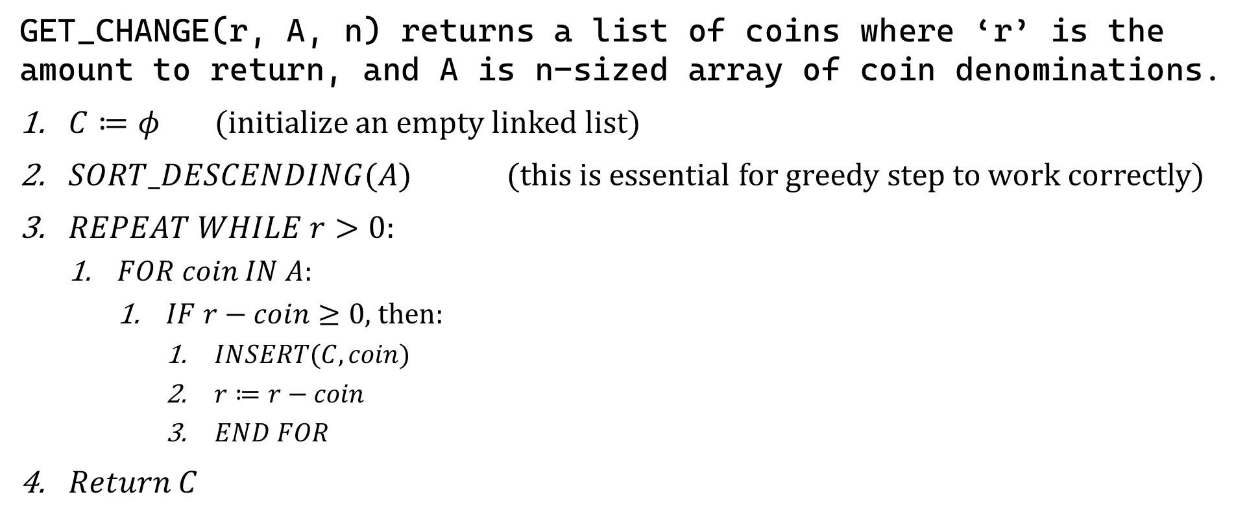
Sample 2
A Simple Example
GET_CHANGE(r, A, n) returns a list of coins where ‘r’ is the amount to return, and A is n-sized array of coin denominations.
$C≔φ$ (initialize an empty linked list)
$SORT_DESCENDING(A)$ (this is essential for greedy step to work correctly)
$REPEAT WHILE r>0$:
$FOR coin IN A:$
$IF r−coin≥0$, then:
$INSERT(C,coin)$
$r≔r−coin$
$END FOR$
$Return C$
Notes:
We cannot use an array for C because its size cannot be determined.

Slide 8
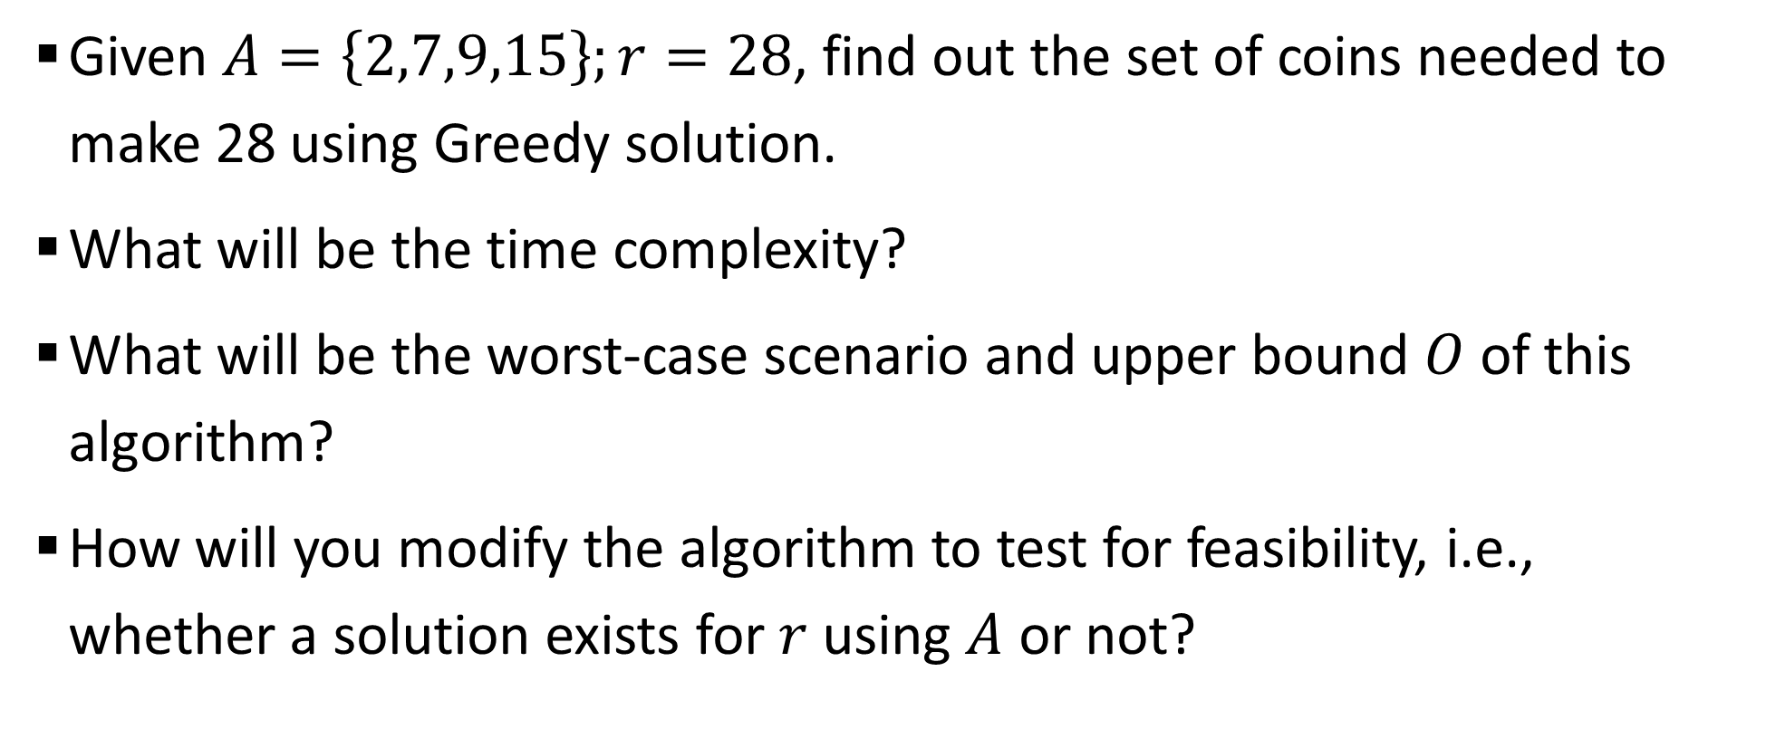
Sample 2
Exercise
Given $A=\left\{2,7,9,15\right\};r=28$, find out the set of coins needed to make 28 using Greedy solution.
What will be the time complexity?
What will be the worst-case scenario and upper bound $O$ of this algorithm?
How will you modify the algorithm to test for feasibility, i.e., whether a solution exists for $r$ using $A$ or not?

Slide 9
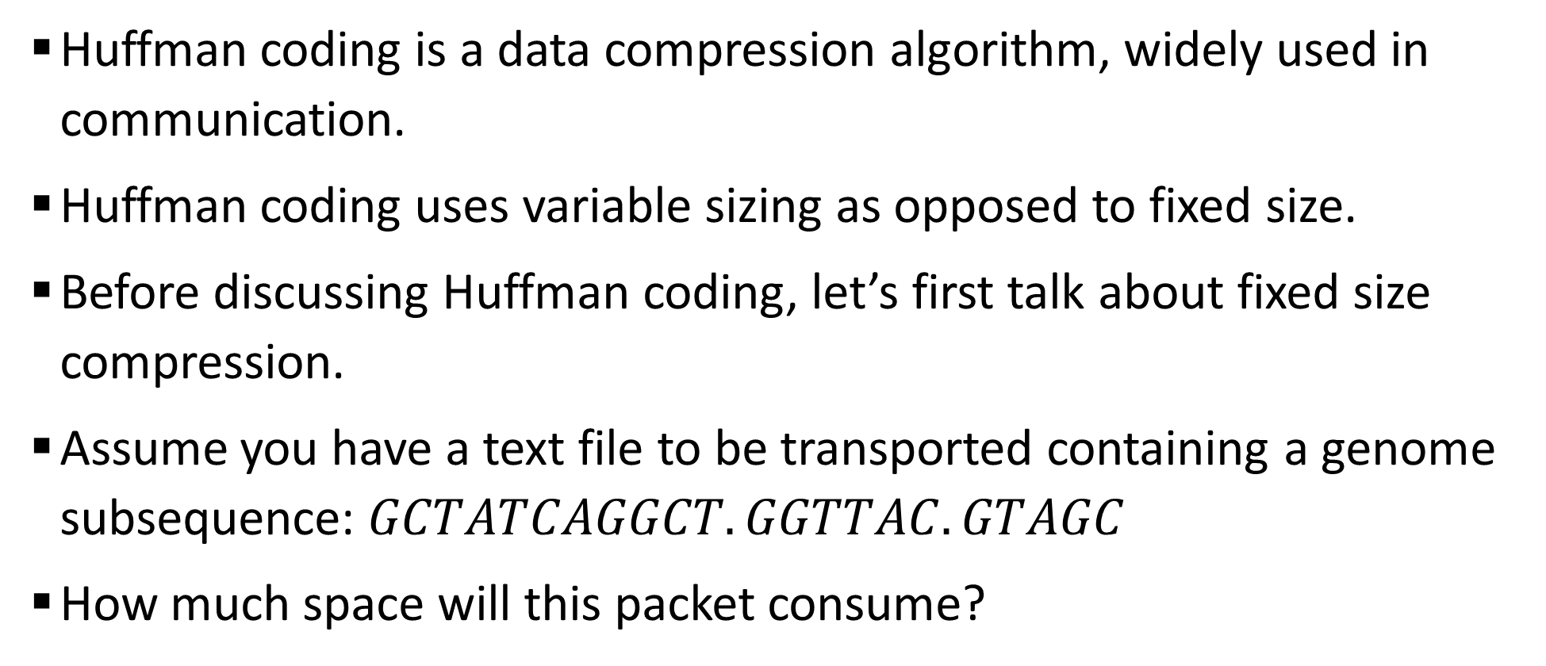
Sample 2
Huffman Coding
Huffman coding is a data compression algorithm, widely used in communication.
Huffman coding uses variable sizing as opposed to fixed size.
Before discussing Huffman coding, let’s first talk about fixed size compression.
Assume you have a text file to be transported containing a genome subsequence: $GCTATCAGGCT.GGTTAC.GTAGC$
How much space will this packet consume?

Slide 10
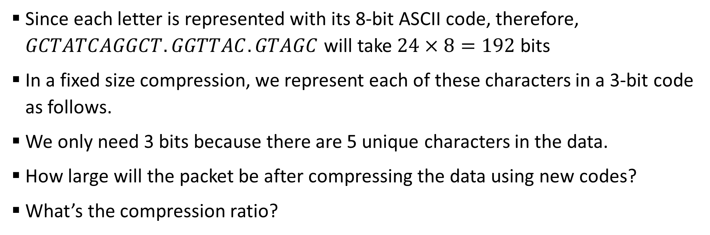
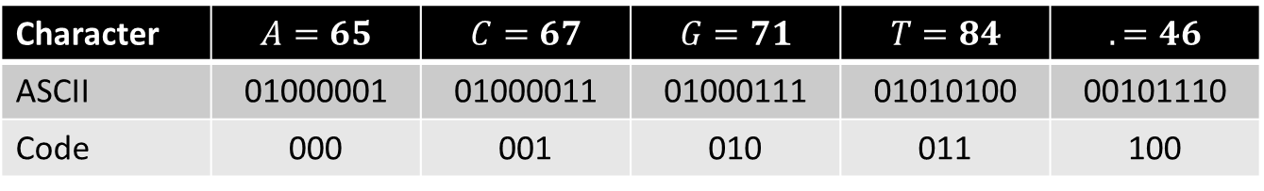
Sample 2
Huffman Coding
Since each letter is represented with its 8-bit ASCII code, therefore, $GCTATCAGGCT.GGTTAC.GTAGC$ will take $24×8=192$ bits
In a fixed size compression, we represent each of these characters in a 3-bit code as follows.
We only need 3 bits because there are 5 unique characters in the data.
How large will the packet be after compressing the data using new codes?
What’s the compression ratio?
Character | $$A=65$$ | $$C=67$$ | $$G=71$$ | $$T=84$$ | $$.=46$$
ASCII | 01000001 | 01000011 | 01000111 | 01010100 | 00101110
Code | 000 | 001 | 010 | 011 | 100
Notes:
We require conversion table to know which code represents what character when uncompressing the data.

Slide 11
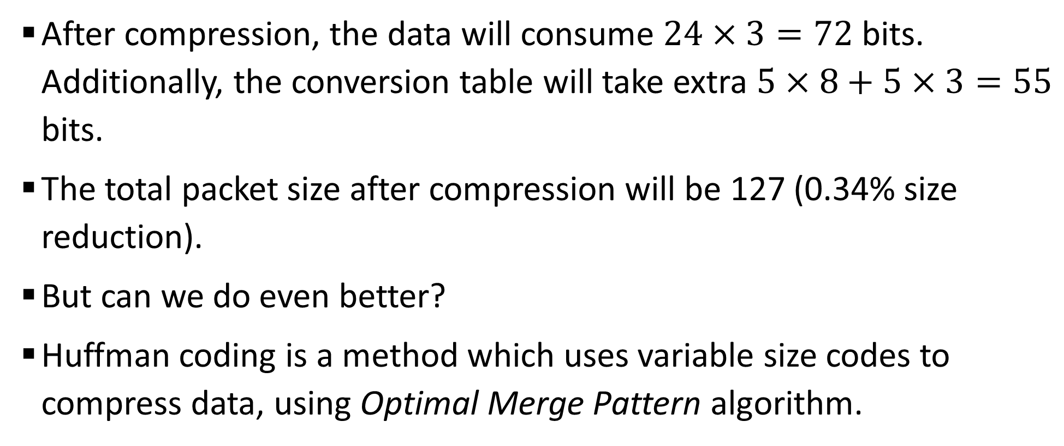
Sample 2
Huffman Coding
After compression, the data will consume $24×3=72$ bits. Additionally, the conversion table will take extra $5×8+5×3=55$ bits.
The total packet size after compression will be 127 (0.34% size reduction).
But can we do even better?
Huffman coding is a method which uses variable size codes to compress data, using Optimal Merge Pattern algorithm.

Slide 12
Sample 2
Huffman Coding
Arrange the characters by frequency in ascending order. These will be leaf nodes of a tree.
Pick the two nodes with minimum frequency and form their parent node by adding their values.
Pick the next two least frequent nodes and form their parent as well.
Repeat until you have a root node which will be the sum of all frequencies, i.e., the length of characters in data.
Assign 0’s and 1’s to the edges. For edge between parent and left child, assign 0; for edge between parent and right child, assign 1.
Huffman code for each character will be the 0’s and 1’s reading from root node to that leaf node.

Slide 13
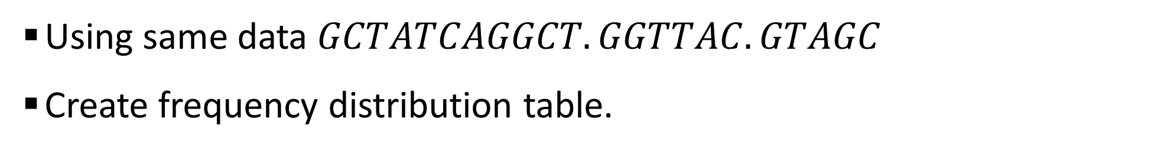
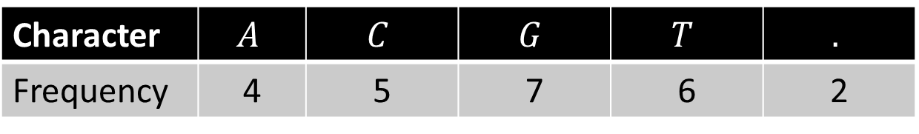
Sample 2
Huffman Coding
Using same data $GCTATCAGGCT.GGTTAC.GTAGC$
Create frequency distribution table.
Character | $$A$$ | $$C$$ | $$G$$ | $$T$$ | $$.$$
Frequency | 4 | 5 | 7 | 6 | 2

Slide 14
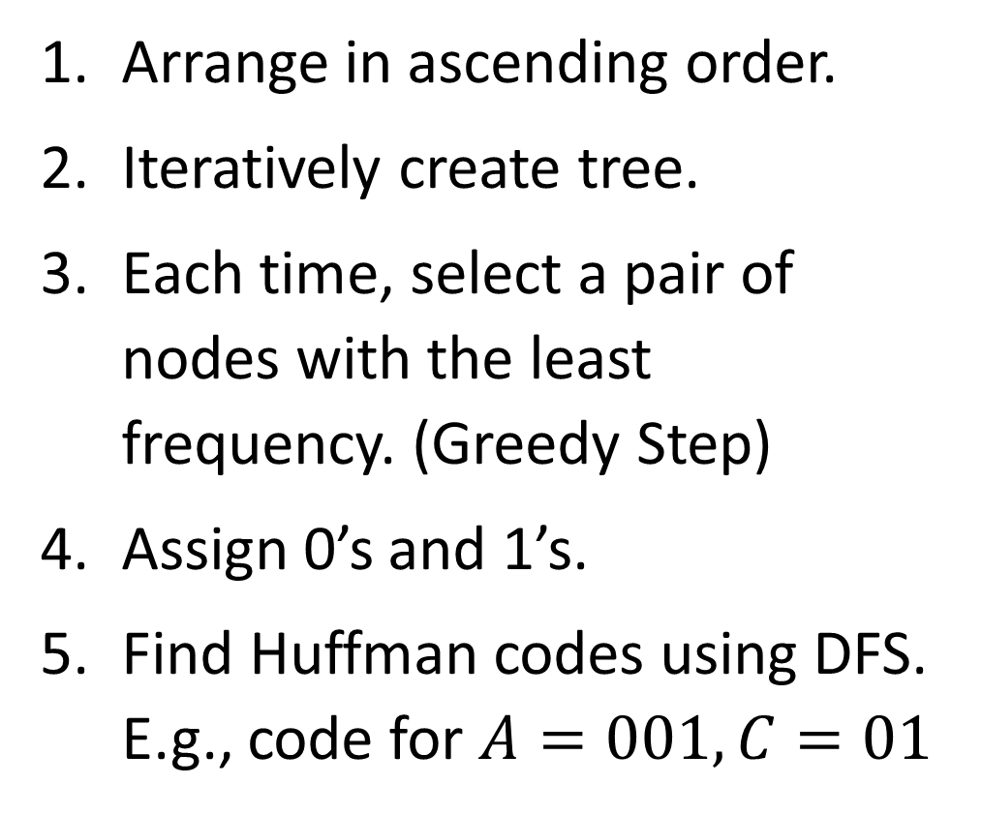
Sample 2
Huffman Coding
Arrange in ascending order.
Iteratively create tree.
Each time, select a pair of nodes with the least frequency. (Greedy Step)
Assign 0’s and 1’s.
Find Huffman codes using DFS. E.g., code for $A=001,C=01$
24
0
1
11
13
0
6
1
0
1
0
1
2
4
5
6
7
.
A
C
T
G

Slide 15
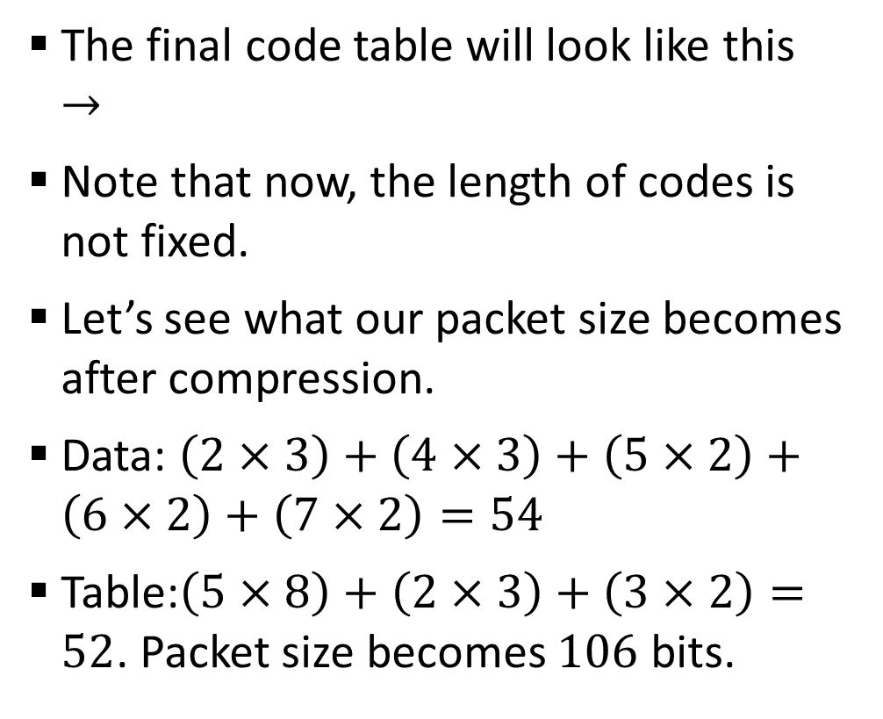
Sample 2
Huffman Coding
The final code table will look like this $→$
Note that now, the length of codes is not fixed.
Let’s see what our packet size becomes after compression.
Data: $\left(2×3\right)+\left(4×3\right)+\left(5×2\right)+\left(6×2\right)+\left(7×2\right)=54$
Table:$\left(5×8\right)+\left(2×3\right)+\left(3×2\right)=52$. Packet size becomes $106$ bits.
Character | Frequency | ASCII Code | Huffman Code
. | 2 | 00101110 | 000
A | 4 | 01000001 | 001
C | 5 | 01000011 | 01
G | 6 | 01000111 | 11
T | 7 | 01010100 | 10

Slide 16
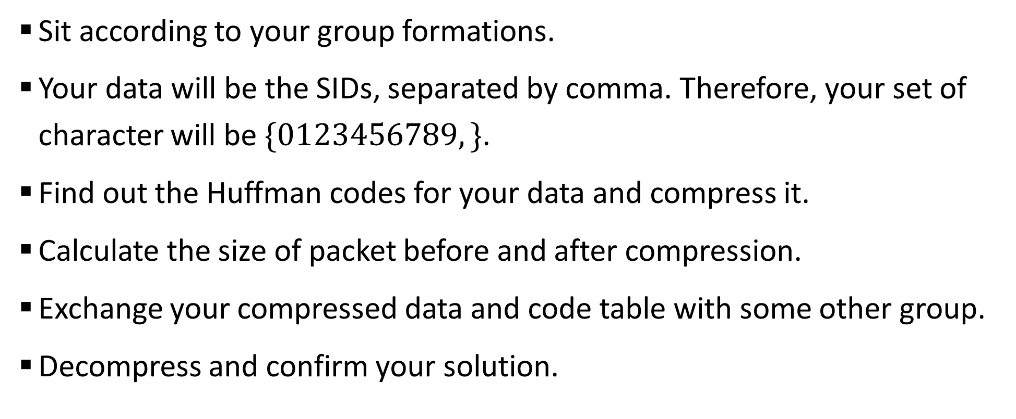
Sample 2
Exercise
Sit according to your group formations.
Your data will be the SIDs, separated by comma. Therefore, your set of character will be $\{0123456789,\}$.
Find out the Huffman codes for your data and compress it.
Calculate the size of packet before and after compression.
Exchange your compressed data and code table with some other group.
Decompress and confirm your solution.

Slide 17
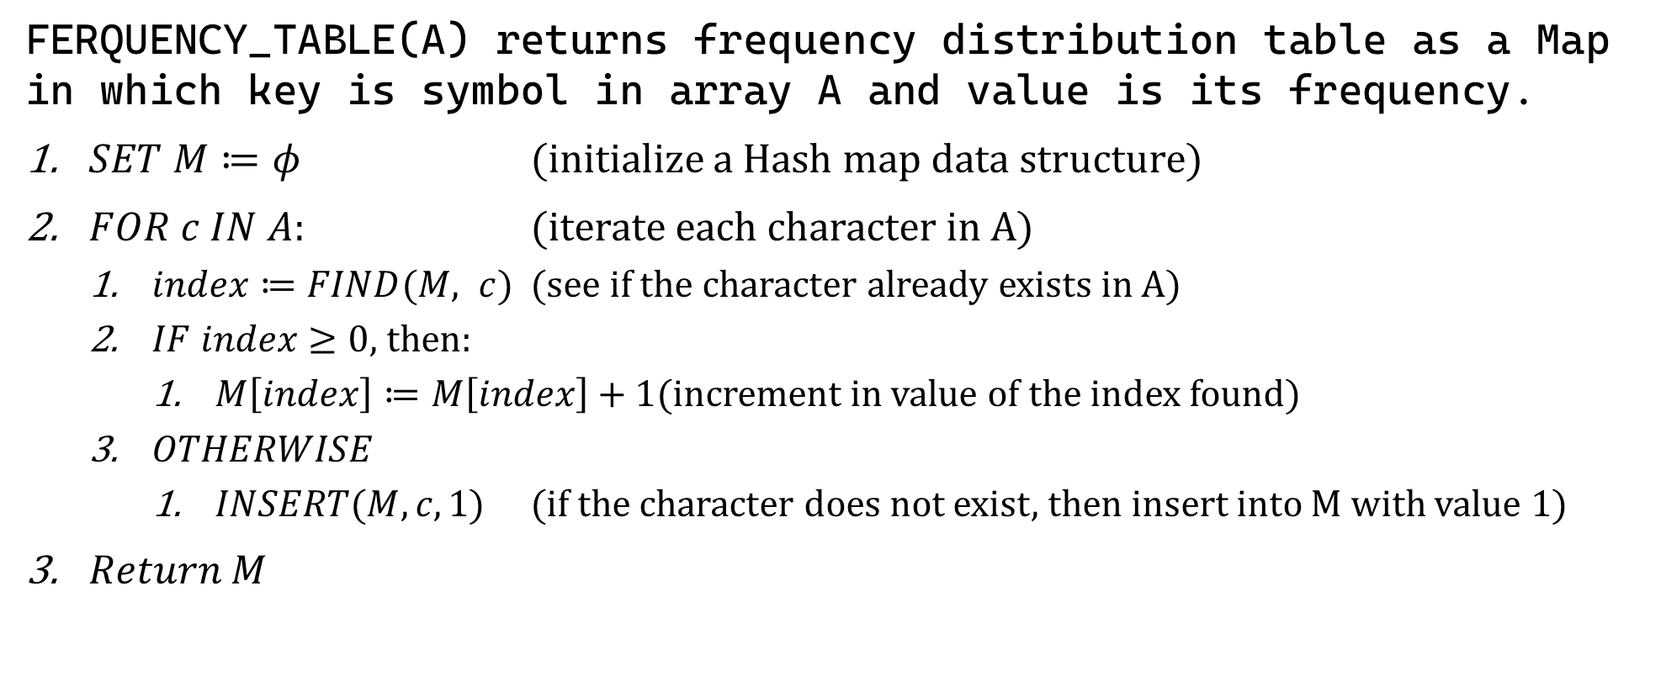
Sample 2
Huffman Coding Algorithm
FERQUENCY_TABLE(A) returns frequency distribution table as a Map in which key is symbol in array A and value is its frequency.
$SET M≔φ$ (initialize a Hash map data structure)
$FOR c IN A:$ (iterate each character in A)
$index≔FIND(M, c)$ (see if the character already exists in A)
$IF index≥0$, then:
$M\left[index\right]≔M\left[index\right]+1$ (increment in value of the index found)
$OTHERWISE$
$INSERT(M, c, 1)$ (if the character does not exist, then insert into M with value 1)
$Return M$

Slide 18
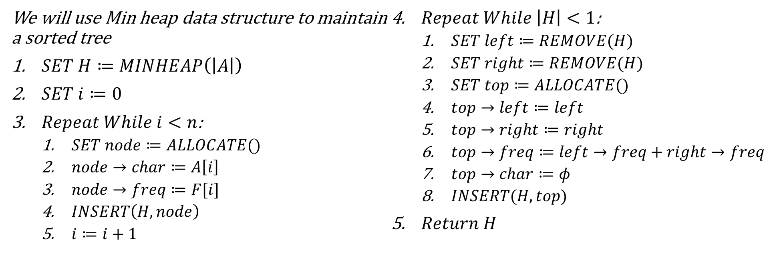
Sample 2
Huffman Coding Algorithm
HUFFMAN_CODING(A, n, F, code) returns a map of characters and their codes. ‘A’ is an array of ‘n’ characters and ‘F’ is an array of frequencies of characters respectively.
We will use Min heap data structure to maintain a sorted tree
$SET H≔MINHEAP\left(\left|A\right|\right)$
$SET i≔0$
$Repeat While i<n$:
$SET node≔ALLOCATE()$
$node→char≔A\left[i\right]$
$node→freq≔F[i]$
$INSERT\left(H, node\right)$
$i≔i+1$
$Repeat While \left|H\right|<1$:
$SET left≔REMOVE(H)$
$SET right≔REMOVE(H)$
$SET top≔ALLOCATE()$
$top→left≔left$
$top→right≔right$
$top→freq≔left→freq+right→freq$
$top→char≔φ$
$INSERT(H, top)$
$Return H$

Slide 19



THANK YOU
Owais Hussain
+92 345-3174270
owais.hussain@kiet.edu.pk
https://www.researchgate.net/profile/Owais-Hussain-3

